Slide 1
AGILE PLAYBOOK
Tips & Tricks for Agile projects in CN
Jan Černý
Scrum Master / GoPro fan
Notes:
5 things to focus on:
Kickoff as a success driver
Why is Poker planning important, how it works
Make sure everybody knows what does DONE means
Feedback is a must

Slide 2
Difference between Agile and Waterfall

Slide 3
Typical (SCRUM) practices
Iterative and Incremental approach
Project is split into “iterations” (Sprints)
Usually 2-3 weeks long
At the end presentation of sprint work and „increment“ added to so far work
Communication is a key
Sprint Planning
Daily standups
Review/Demo
Retrospective
Changes are allowed and necessary

Slide 4
TYPICAL (SCRUM) ROLES
Team
Develops the product based on PO priorities
Presents results of the sprint
Scrum Master
„Smooth Operator“ and Impediment buldozer

Slide 5
Most important role: PRODUCT OWNER
Gathers/Provides feedback (Middle man)
For/From Stakeholders or even end users
For/From the team during Demos/Daily
Attends all Scrum Meetings
All of them including daily standups
Accessible for the team within reasonable timeframe

Slide 6
Typical Agile project setup in CN
Scrum Methodology
Iteration(Sprint) length
2 weeks
Agreed meetings
Milestone Kickoff
Sprint Planning (Grooming)
Daily standup
Sprint Review
Sprint Retrospective
Milestone Retrospective
Dedicated Product Owner
Attending all meetings
PM or TL as a Scrum Master

Slide 7
5 things WHAT TO focus ON your pROJECT!

Slide 8
1. KICKOFF MEETING iS A SUCCESS DRIVER

Slide 9
What is a kickoff meeting (Bad Example)

Slide 10
Try to understand your product needs
Current situation and challenges
Business goal of the project
Purpose of the project
Target users
Typical user, other users
User roles
Major parts (briefly)
Presentation of big features which brings solution
Deadline or budget constraints

Slide 11
Groom the backlog together
Process of backlog grooming:
Product Owner is describing backlog items to the team
Team together with PO shape the description of the backlog item
Format of backlog item:
User Story format ”As a *role* I want *functionality* so that *usecase*”
Good User Story should follow INVEST rule

Slide 12
2. Don`t be afraid of Poker planning

Slide 13
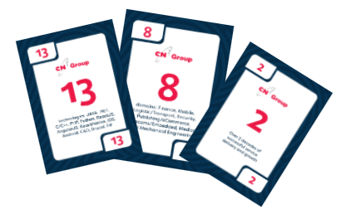
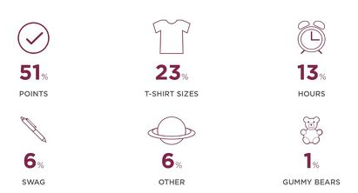
Group estimation – Poker Planning
PO introduce User story and discussion begins
Team checks if they understand story, prerequisites, out of scope, …
First round of independent estimation
MIN and MAX numbers present their arguments for numbers
Second round of estimation

Slide 14
But What is the goal of the session ?

Slide 15
Poker planning example on 1 USER STORY

Slide 16
How long does a woman need to prepare for a date ?

Slide 17
3. Make sure That everybody knows what does DONE mean

Slide 18
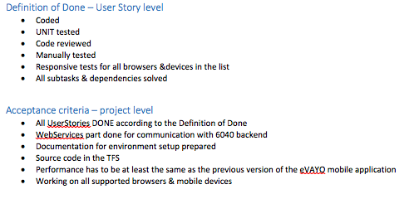
DoD vs Acceptance Criteria
Definition of Done (DoD)
List of activities for every story to be able to mark it as DONE.
Can have different levels
Story
Sprint
Release (Acceptance criteria)
Acceptance criteria
List of conditions that need to be met to consider project as Finished
Alligned with non-functional requirements

Slide 19
Kickoff meeting agenda (2 days)
Milestone Retrospective
Business idea presentation
Backlog grooming
Poker Planning
Definition of Done / Acceptance Criteria
Project cooperation rules
Planning of Sprint 1

Slide 20
Tips and tricks Sprint review / demo
Notes:
Main asset of product oriented companies: SW/Code
Main asset of service oriented companies: People
Other assets: Reputation, Relationships, .. But still the main asset: People!
Our goal is to protect our asset!

Slide 21
4. Feedback is a must tips for Demo and Retrospective

Slide 22
Sprint Review / Demo
Enough time for preparation
CodeFreeze
Who should attend Demo?
Product Owner + Dev. Team
Stakeholders
Product Owner of other teams
End users
Demo = Presentation of Stories
Either each member present own stories or 1 presenter role which is rotating
Tell what was goal of the sprint vs result
Present stories from user point of view (Story / Usecase)
Sell also your effort on technical stories

Slide 23
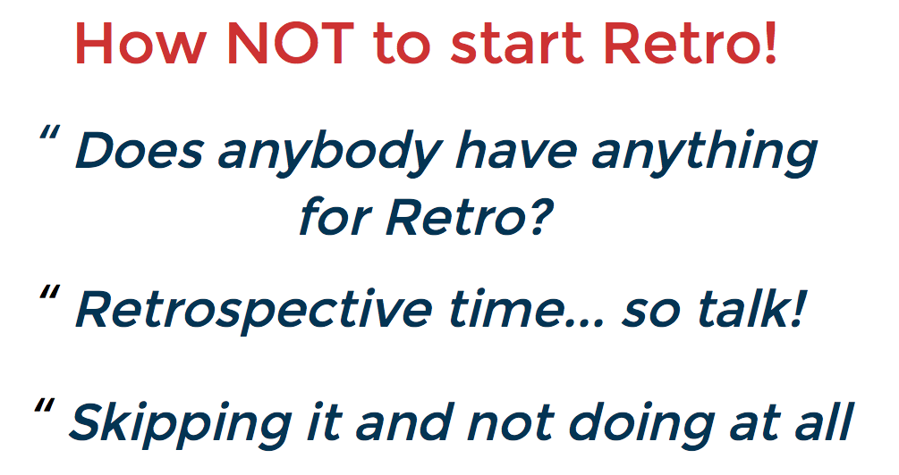

Slide 24
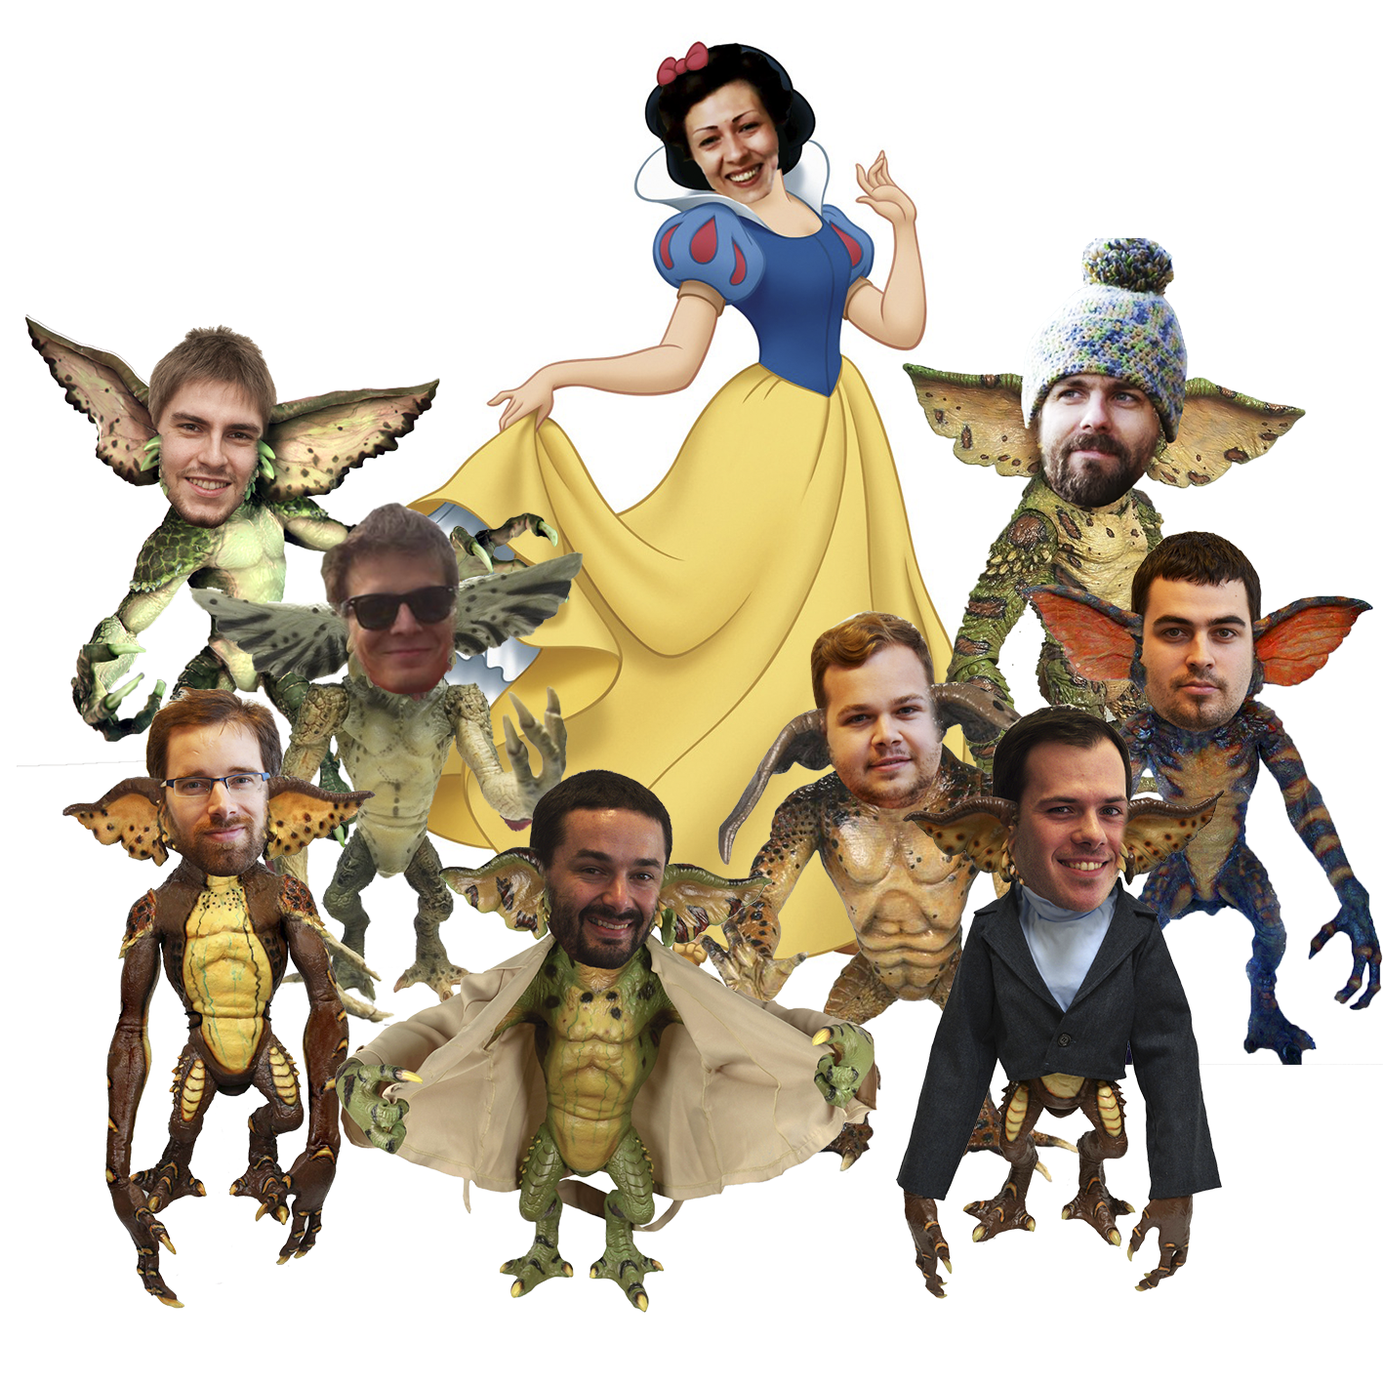

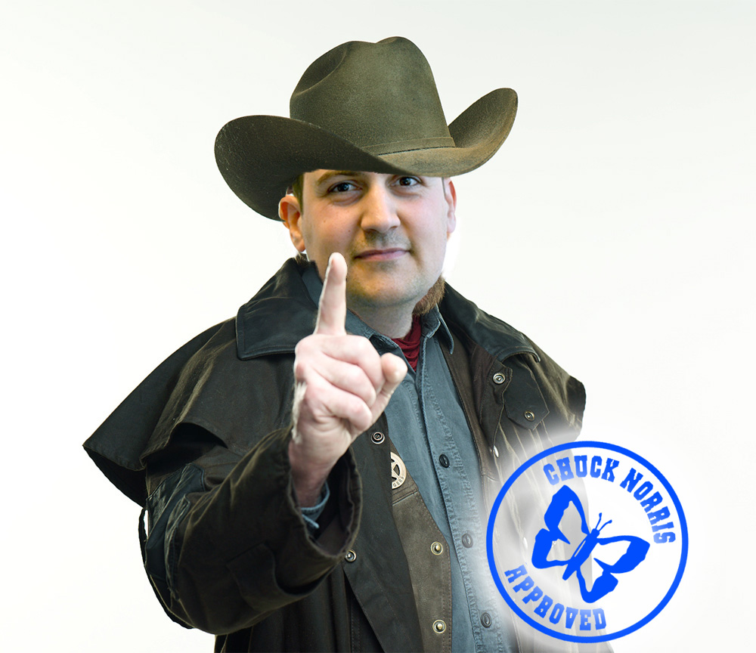
Tips for your Retrospectives
Physical retrospectives over tools!
Do not improvize! 10 min for generating ideas
Action point format: START, STOP, CONTINUE
Present your points one by one
Do not critise!
Write your points and check if they were DONE
Select HERO of the sprint

Slide 25
5. Setup your mindset on mvp mode
Notes:
Main asset of product oriented companies: SW/Code
Main asset of service oriented companies: People
Other assets: Reputation, Relationships, .. But still the main asset: People!
Our goal is to protect our asset!

Slide 26
MVP
Minimal viable product

Slide 27
∞. different project different agile setup
Notes:
Its not bad… you should not do agile according to book
The only necessary thing is if how its set up works and that team benefits from it
With all the PMs we are trying to make sure its in safe borders but if you will feel its not… its your moral duty to say it loud ;)

Slide 28
WILL / WON`T
Agile practices won`t prevent problems to happen
Agile practices/praxes will help with communication and transparency and fast feedback cycles
Agile is a mindset
You should believe that living Agile values this will help you on your project
We are trying to pick people with aim on Agile mindset
Share your troubles with your colleagues and PMs
And JUST OK is not enough

